Slide 1

Team 3 Sujata Vithala Ronald Martis Indira Tejaswini Vadlapatla Pallavi Donwad
Exploratory Analysis on Flight Operations

Slide 2
Project Summary
The objective of this project is to study the flight operations of major domestic airlines in 2016 through the analysis of delays, cancellation and diversions.
Data Analysis is done comparing key parameters such as flight volume, delays, cancellations and diversion rates.
Results from the data is used for analysis of flight operations.

Slide 3
Goals
Summarize data by time periods, airports and carriers
Temporal effects
Are some time periods more prone to delays than others?
Relationships between delays and
Seasonal factors
Weather factors
Daily factors
Spatial effects
Are some airports more prone to delays than others?
Carrier effects
Are some carriers more prone to delays than others?
Delay reasons
Cancellation reasons

Slide 4
Data Sources
Kaggle - https://www.kaggle.com/usdot/flight-delays/data - To
analyze with 2016 Flight Data.
Bureau of Transportation Statics -https://www.transtats.bts.gov/DL_SelectFields.asp –The data comes from the On-Time Performance table.
Google Maps JavaScript API
Geo Code API

Slide 5
Data Cleanup & Exploration
Data Cleaning – Extract, Analyze the raw dataset through importing csv files into Pandas data-frames. Clean the raw dataset to remove extraneous columns, null data points, etc.
Data Scraping – Query the chosen APIs to retrieve data based on the chosen dataset
Data Exploration – Create meaningful combinations of sub-data from the main data set using aggregation function in Pandas data frames
Compute Relationships - Compute relations among key variables/columns in the data-frames to arrive at relationships
Analysis – Visualization of the data relationships using plotting libraries

Slide 6
Data Visualization

Slide 7
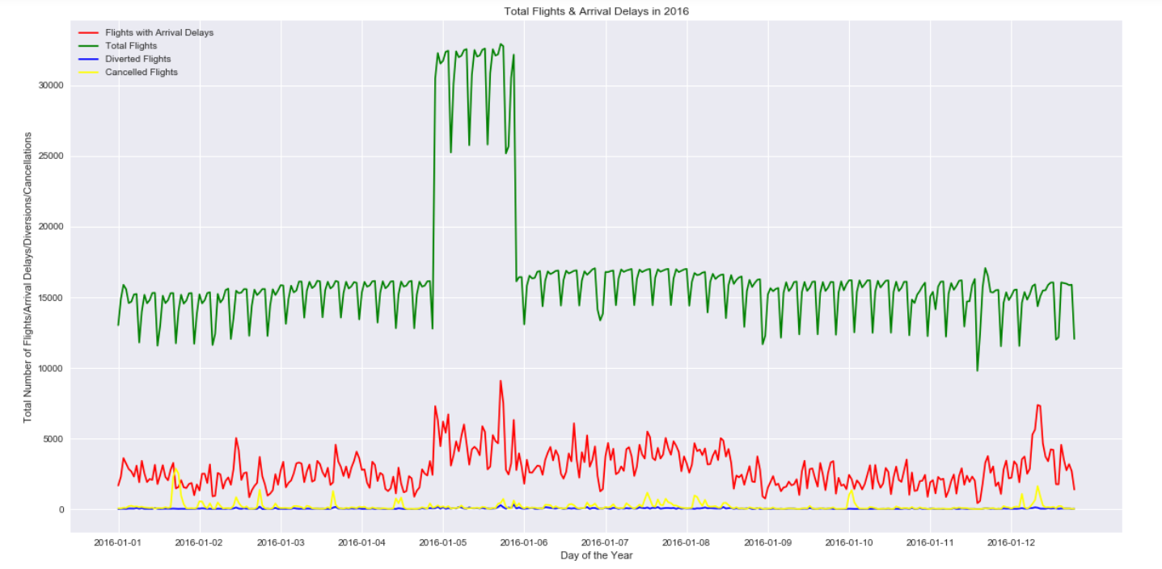
Temporal Analysis Flights, Arrival Delays vs Time Period
Total Flights And Delays Peak In May
Dips In Total Flights Correspond To Weekends
Cancellations Peak In December And January
Diversion Are Flat Through The Year

Slide 8
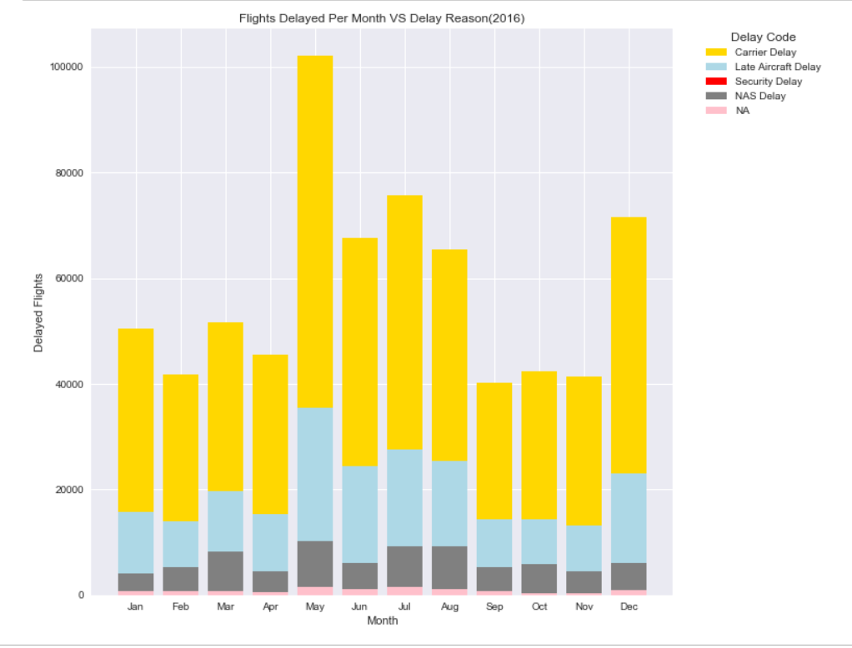
TIME Analysis Reasons for delays
Major Delays Are Due To Carrier Delays

Slide 9
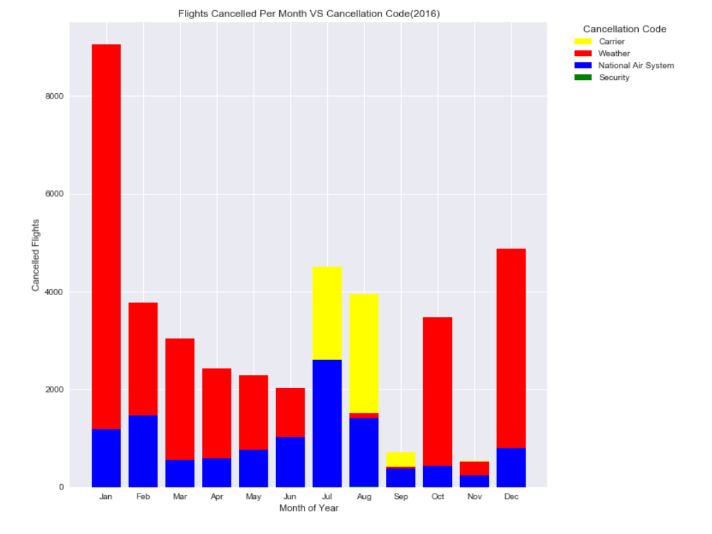
Weather seems to be the main reason for cancellation except for the months of July, August and September
Reasons for Cancellations

Slide 10
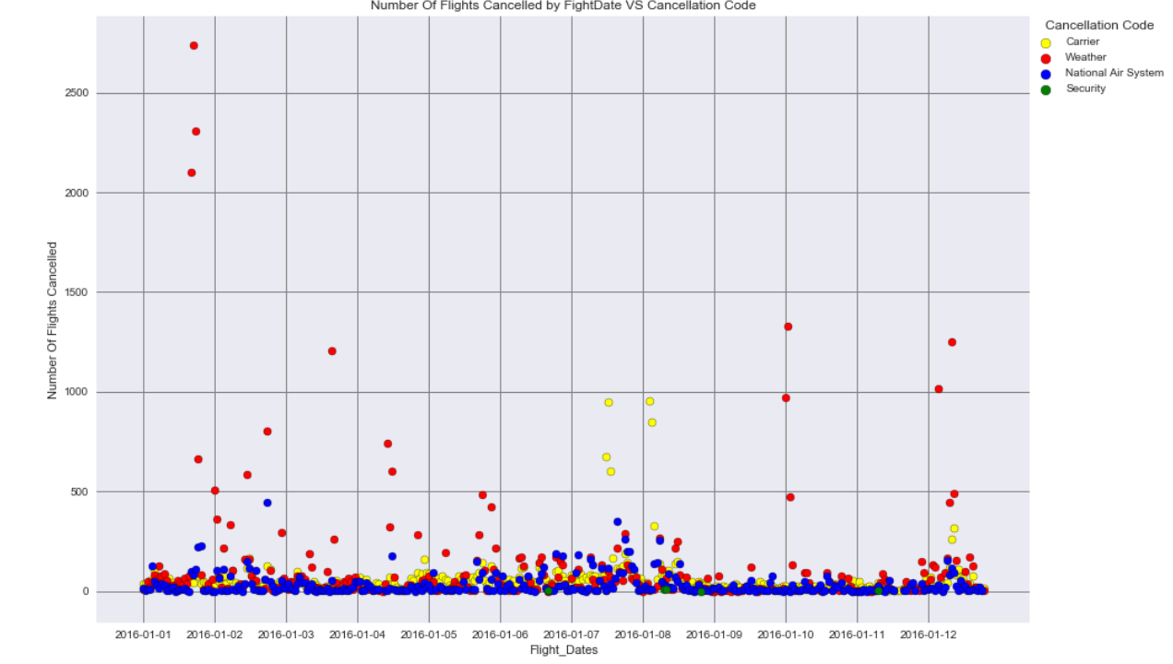
Number of Flights cancelled by Flight date vs Cancellation code

Slide 11
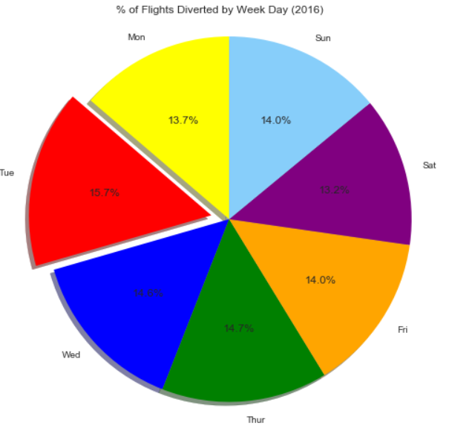
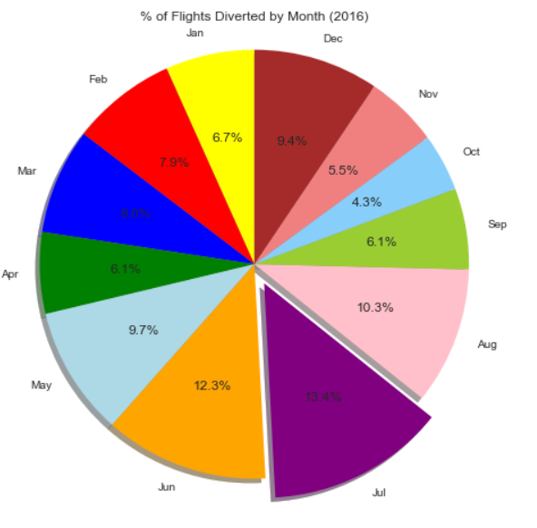
Flights diversions

Slide 12
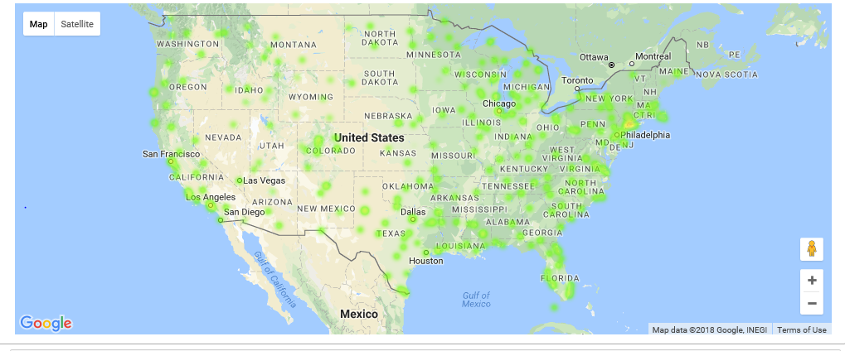
Average delays of various airports
The Maximum Delays in New York Area.

Slide 13
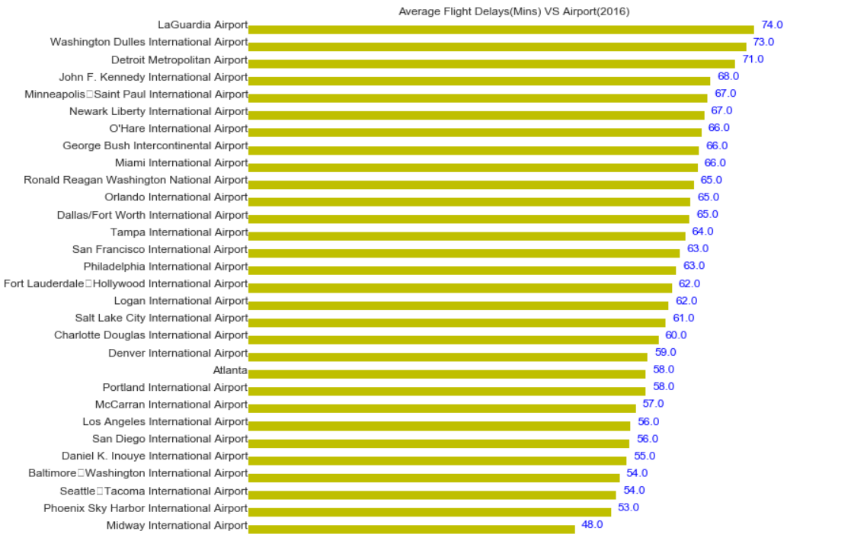
Average flight delays by top 30 airports

Slide 14
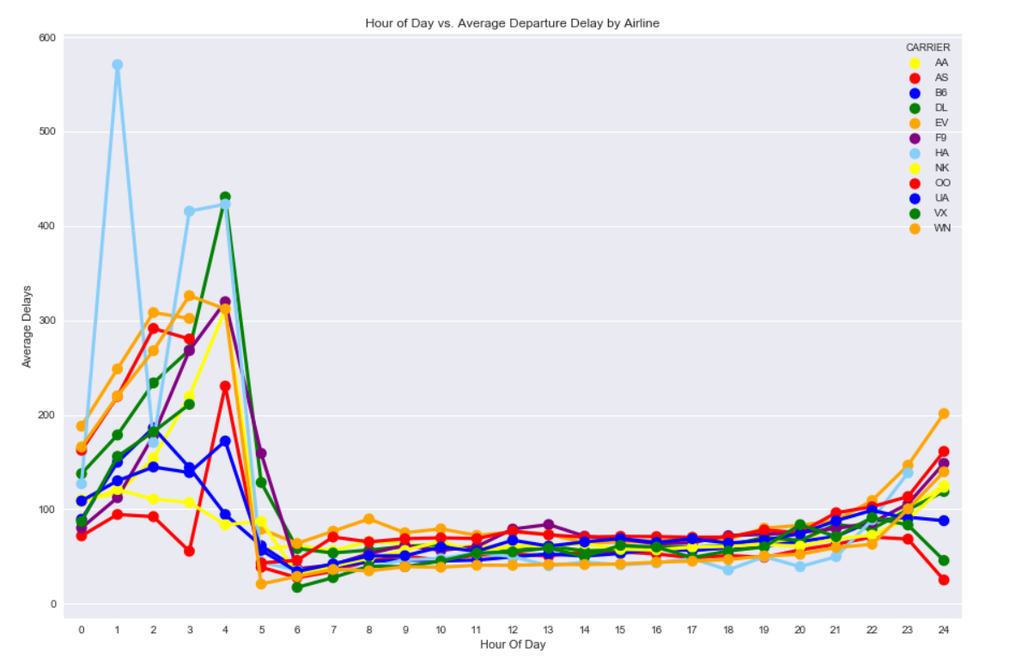
Departure delays by carrier
Major delays occurs in early morning flights for all airlines

Slide 15
Difficulties: > Large Volume Of Month By Month Data. > Gathering & Merging Data Challenges > Delay Reasons Scattered Across The Four Columns And Combined Into One Column > Error Loading Gmap Was Rectified By Getting Separate Api Key > Plotting Challenges What Would You Research Next, If You Had Two More Weeks? > Collect Data For Couple Of More Years And Perform Yearly Comparison > Do Regression And Sentiment Analysis Based On Historical Data
POST MORTEM

Slide 16
Conclusions
1)Flights were mostly delayed during early hours
2)Most of the delays were in the north east concentrated around NY area
3)Most delays were carrier related while most cancellations were weather related
4)Delays are more during summer months and cancellations are more during winter months
5)Diversion Rates were highest during July

Slide 17
Questions ??

